Slide 1

Best Practices in Software Development
Gabriel Teris
Gemini Solutions
http://www.geminisols.com

Slide 2
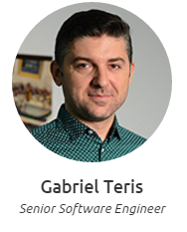
Despre mine
1996 – 2001 -> participare la toate olimpiadele de informatica locale si judetene
2001 – 2006 -> Automatica si Calculatoare
2005 - 2015 -> Programator Java
ianuarie 2013 – prezent -> Gemini Solutions
http://about.me/gabi.teris
GEMINI SOLUTIONS - DEVELOPMENT FUNDAMENTALS

Slide 3
Big Picture
Ian Sommerville has identified four generalised attributes of good software, which are not concerned with what a program does, but how well the program does it:
Maintainability.
Dependability.
Efficiency.
Usability.
GEMINI SOLUTIONS - DEVELOPMENT FUNDAMENTALS
Notes:
Acum sa discutam putin despre software quality, si cum anume implementam niste reguli de buna practica pentru a obtine un cod curat si mentenabil.

Slide 4
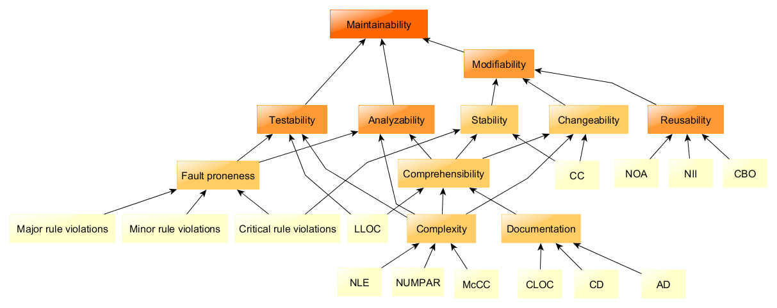
Mantainability
Notes:
In engineering, maintainability is the ease with which a product can be maintained in order to:
isolate defects or their cause,
correct defects or their cause,
repair or replace faulty or worn-out components without having to replace still working parts,
prevent unexpected breakdowns,
maximize a product's useful life,
maximize efficiency, reliability, and safety,
meet new requirements,
make future maintenance easier, or
cope with a changed environment.

Slide 5
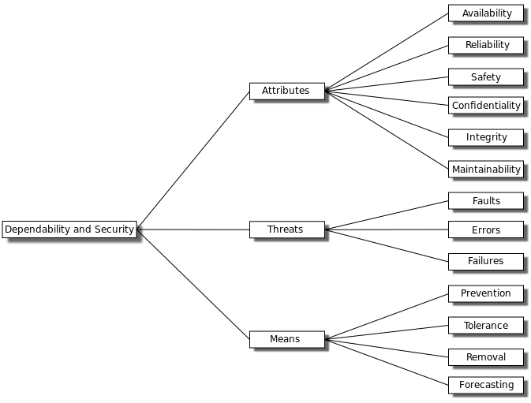
Dependability
Notes:
https://en.wikipedia.org/wiki/Dependability

Slide 6
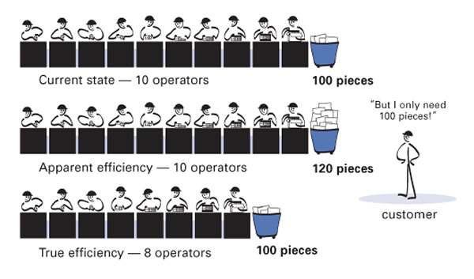
Efficiency
Notes:
Efficiency is the (often measurable) ability to avoid wasting materials, energy, efforts, money, and time in doing something or in producing a desired result.
https://en.wikipedia.org/wiki/Efficiency

Slide 7
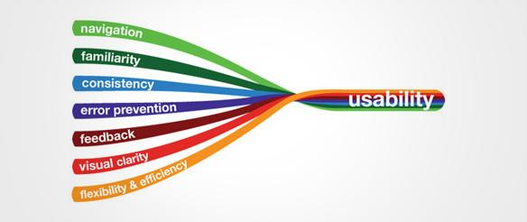
Usability
Notes:
In software engineering, usability is the degree to which a software can be used by specified consumers to achieve quantified objectives with effectiveness, efficiency, and satisfaction in a quantified context of use.
https://en.wikipedia.org/wiki/Usability

Slide 8
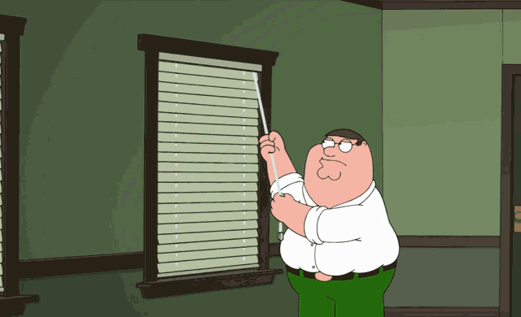

Slide 9


Slide 10

Remember…
Team work
IDE’s
Code style
Code formatting
Notes:
Sa ne amintim putin ce ati invatat in scoala, si ce ati retinut din sesiunile trecute ale cursului

Slide 11
Remember refactoring?
Refactorizarea codului sau „code refactoring” este procesul de modificare a unei secvențe de program fără a-i schimba funcționalitatea externă:
Uneori prin refactorizare se înțelege simpla reorganizare a codului însă…
Deseori prin refactorizare funcționalitatea internă e schimbată prin optimizarea codului existent sau prin folosirea unor algoritmi mai buni. Acest proces se mai numește și „software re-engineering”;
Refactorizarea vizează în principal îmbunătățirea structurală a unui codul existent – cod care a fost testat și validat anterior - având ca obiective finale:
Reducerea complexității;
Creșterea lizibilității și implicit a mentenabilității codului;
Modificarea internă a acestuia în vederea extinderii codului cu noi opțiuni (capacitatea codului de a fi extensibil);

Slide 12
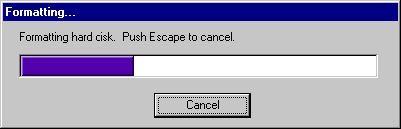
Definition
What is formatting?
Code formatting is about communication, and communication is the professional developer’s first order of business. Perhaps you thought that “getting it working” was the first order of business for a professional developer. (Robert Martin, Clean Code)
GEMINI SOLUTIONS - DEVELOPMENT FUNDAMENTALS
Notes:
Sa ne amintim cum a decurs exercitiul de desenare a unei case in echipe, fara sa comunicati. How did that go? :)
Avem nevoie de a stabili niste standarde de lucru, si pasii pe care ii vom face…
Dau exemplu de formatare diferita la proiect Yummly.
Using a bad Coding Style is worse than having no Coding Style at all, since you will be extending bad practices to all the code base.
First of all, let's be clear. Code formatting is important. It is too important to ignore and it is too important to treat religiously. Code formatting is about communication, and communication is the professional developer’s first order of business. Perhaps you thought that “getting it working” was the first order of business for a professional developer. I hope by now, however, that this book has disabused you of that idea. The functionality that you create today has a good chance of changing in the next release, but the readability of your code will have a profound effect on all the changes that will ever be made. The coding style and readability set precedents that continue to affect maintainability and extensibility long after the original code has been changed beyond recognition. Your style and discipline survives, even though your code does not.

Slide 13
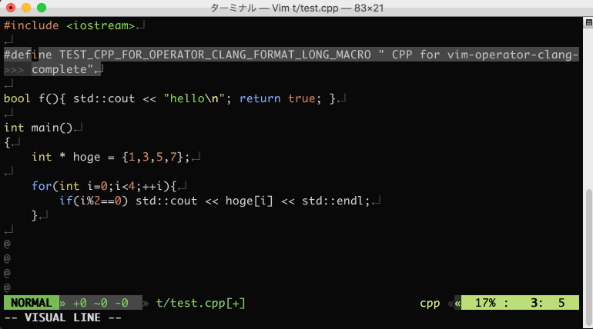

Slide 14
GNU Coding Standards
formatting source code
indentation and whitespaces
comments
naming variables, functions and files
logs
makefiles
Code style conventions
GEMINI SOLUTIONS - DEVELOPMENT FUNDAMENTALS
Notes:
Sa vedem niste standarde GNU pentru redactarea optima a codului
https://en.wikibooks.org/wiki/C%2B%2B_Programming/Programming_Languages/C%2B%2B/Code/Style_Conventions
Exemple din viata reala: github pull requests
Naming conventions
classes - nouns, camel case, simple and descriptive
interfaces - same as classes
methods - verbs, mixed case
variables - short and meaningful; avoid 1 char names; i,j,k,m,n integers, c,d,e characters
constants - full caps with underscores separation
Wrapping Lines:
break after comma
break before operator
prefer higher-level breaks to lower-level breaks
align the new line with the beginning of the expression at the same level on the previous line
if the above rules lead to confusing code, just indent 8 spaces
Comments: implementation comments /* */ and documentation comments. /** JAVADOC */
Make the code speak: The frequency of comments sometimes reflects poor quality of code. When you feel compelled to add a comment, consider rewriting the code to make it clearer.
Number per line: one declaration per line is recommended since it encourages commenting
int level; // indentation level
int size; // size of table
Placement: Put declarations only at the beginning of blocks.
The one exception to the rule is indexes of for loops, which in Java can be declared in the for statement:
for (int i = 0; i < maxLoops; i++) { …
Initialization: Try to initialize local variables where they’re declared. The only reason not to initialize a variable where it’s declared is if the initial value depends on some computation occurring first

Slide 15
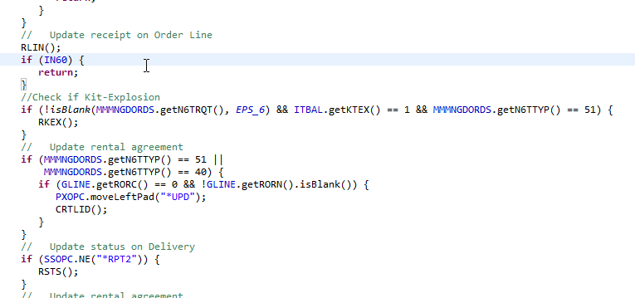
Notes:
https://github.com/yummly/android-app/pull/9/files

Slide 16
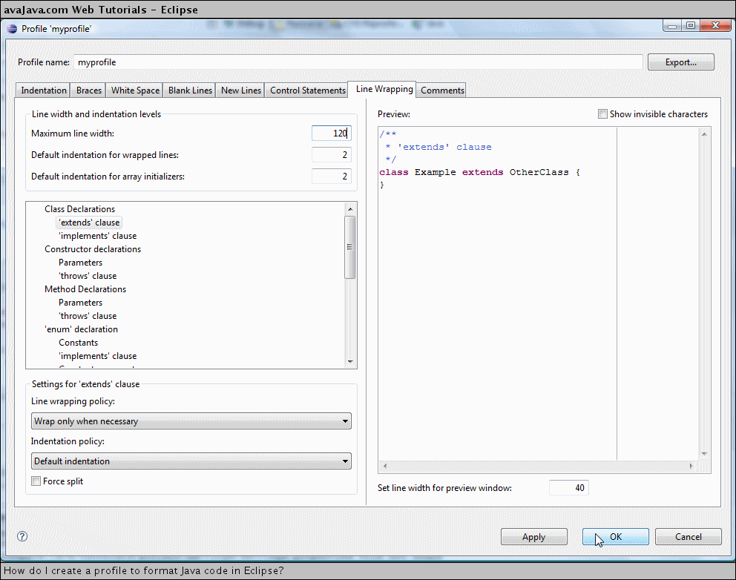

Slide 17
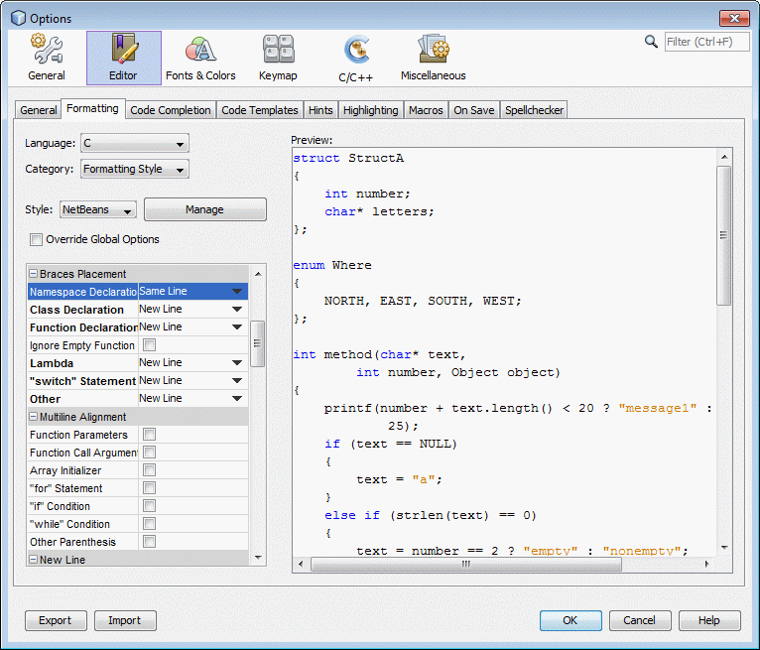

Slide 18
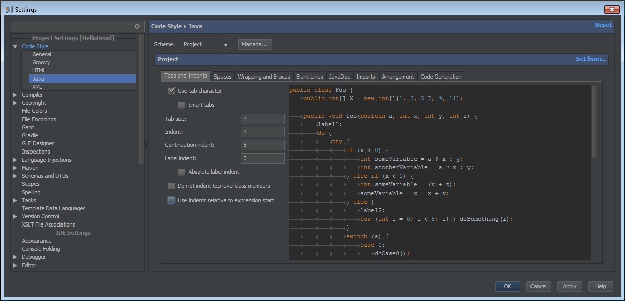

Slide 19
Code Conventions
avoid assigning the same value to several variables:
fooBar.fChar = barFoo.lchar = 'c'; // AVOID!
Do not use the assignment operator in a place where it can be easily confused with the equality operator:
if (c++ = d++) { // AVOID!
operator precedence
if (a == b && c == d) // AVOID!
if ((a == b) && (c == d)) // RIGHT
GEMINI SOLUTIONS - DEVELOPMENT FUNDAMENTALS
Notes:
if (condition) {
return x;
}
return y;
should be written as
return (condition ? x : y);
If an expression containing a binary operator appears before the ? in the ternary ?: operator, it should be parenthesized. Example: (x >= 0) ? x : -x
Use XXX in a comment to flag something that is bogus but works. Use FIXME to flag something that is bogus and broken.

Slide 20
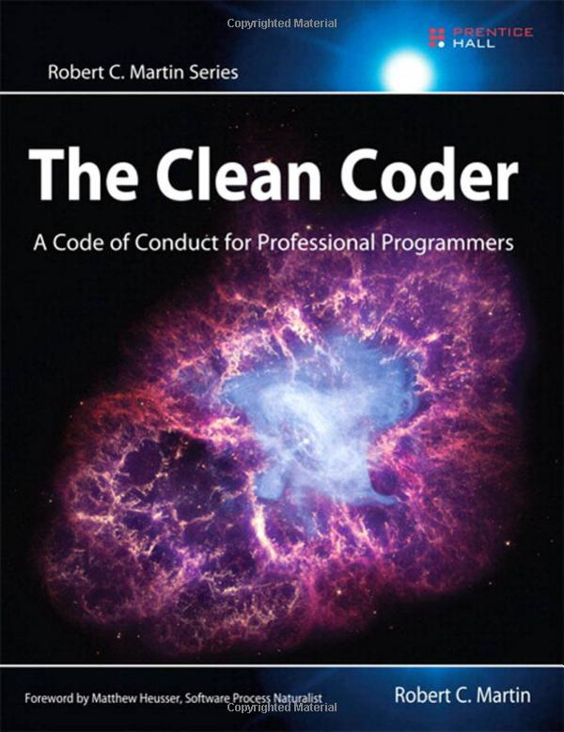


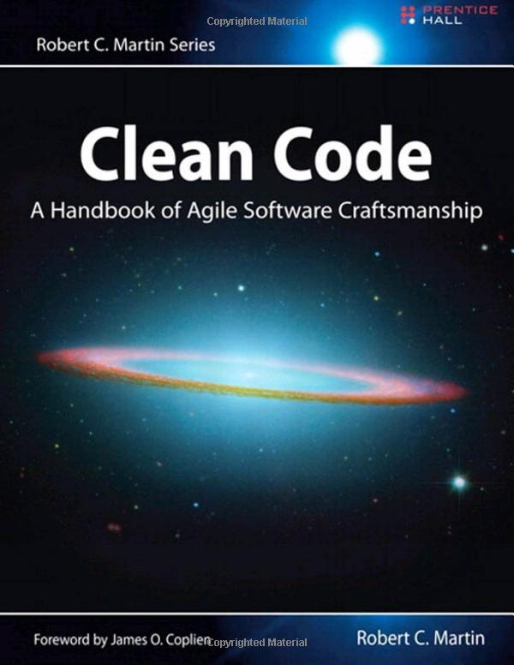

Slide 21

Can you focus?
Techniques
Pomodoro
Software
RescueTime
Notes:
RescueTime: https://www.youtube.com/watch?v=SPuv4PVOg6E

Slide 22
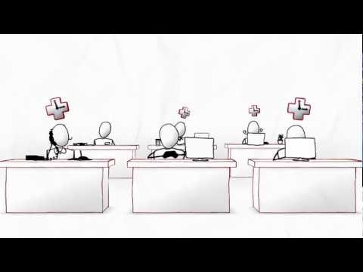
Introduction to RescueTime: https://www.youtube.com/watch?v=_zHNWACOGjk
GEMINI SOLUTIONS - DEVELOPMENT FUNDAMENTALS

Slide 23

Pomodoro: https://www.youtube.com/watch?v=CT70iCaG0Gs
GEMINI SOLUTIONS - DEVELOPMENT FUNDAMENTALS

Slide 24
Stay focused
set clear goals; make daily to-do lists
work in 60-90 minute blocks
turn off the world
schedule distractions; stay away from social networks
practice not being distracted
pay attention to yourself (even put on headphones) d(^_^)b
use technology to your advantage
GEMINI SOLUTIONS - DEVELOPMENT FUNDAMENTALS
Notes:
Set clear goals: Instead of saying, “I’m going to work a solid eight hours every day,” make a list of your top priorities for the week. This helps you avoid reacting to every distraction that comes up. Review your list each morning and decide—realistically—what tasks you can accomplish that day. Be concrete: “I’m going to finish steps 1-3 of the project by noon.”
Work in 60-90-minute blocks: As we work, our alertness drops off, increasing the lure of distractions. Set a timer and take a break at the end of each cycle. Reset your focus by listening to music for a few minutes, taking a short walk, or going for lunch.
Turn off the world: Let’s face it, the world is a distracting place. Avoid temptation by severing all ties. This includes email, office phones, cell phones and your coworkers. This might require finding a quiet place away from your office to work—such as booking a conference room or hiding out in your office. If you need to, set up a system for urgent messages to reach you. This doesn’t include where to go for happy hour.
Schedule distractions: Distractions are not all bad, but you need to make them work for you. Use them as reward for a solid chunk of work. Start out with distractions that are good for you, such as working out or calling your friends. If Facebook and Twitter are your thing, block off time in your schedule to post or browse other people's updates, but stick to your schedule. Remember, you control the distractions.
Practice not being distracted: Meditation is a great way to do this because it’s just you and your thoughts. If that’s not your thing, practice single-tasking throughout your day. At lunch, just eat. Don’t read the newspaper or check your email at the same time. In meetings, don’t doodle in your notebook or play with your phone.
Pay attention to yourself: Start to notice when and how you get distracted. What thoughts happen just before that? Are you tired, hungry, or bored? As you learn what triggers your distractions, you can head them off before you slip into an hour-long IM chat.
Use technology to your advantage: From blocking out distracting websites to tracking how much time you spend surfing the web, many apps can actually help you stay focused. Once you identify what your habits are, pick one that will help you meet your goals, but don’t let these become distractions in themselves.

Slide 25

Checklists
Benefits of checklists
Focus on likely sources of error
Form quality standard that aids preparers
Can bring up issues specific to a product
Focus
Priority issues
Issues unlikely to be found other ways
Historical problems
Issues specific to the document
Should be short
About seven items
If more, group and do multiple passes
Start with checklist from well-known source
Refine based on experience
Notes:
Checklist Items from the Web
• Specification
Are the javadocs complete, including DBC or Error checking specs as appropriate?
• Design
Can better data structures or more efficient algorithms be used?
Are error messages comprehensive and provide guidance as to how to correct the problem?
Is there duplicate code that could be replaced by a call to a function that provides the behavior of the duplicate code?
Do any derived classes have common members that should be in the base class?
• Coding
Have all array (or other collection) indexes been prevented from going out-ofbounds?
Is integer arithmetic, especially division, used appropriately to avoid causing unexpected truncation/rounding?
Are all files closed properly, even in the case of an error?
Are all object references initialized before use?
In a switch statement, are all cases by break or return?
Are all objects (including Strings) compared with "equals" and not "=="?
• Style
Are descriptive variable and constant names used in accord with naming conventions?
Are there literal constants that should be named constants?

Slide 26
Code and code complexity metrics
Clang: http://clang-analyzer.llvm.org/
Cppcheck: http://cppcheck.sourceforge.net/
CppDepend: http://www.cppdepend.com/
GEMINI SOLUTIONS - DEVELOPMENT FUNDAMENTALS
Notes:
https://en.wikipedia.org/wiki/List_of_tools_for_static_code_analysis#C.2C_C.2B.2B

Slide 27
Code and code complexity metrics
Checkstyle
Findbugs
Emma
JArchitect
Sonar: http://nemo.sonarqube.org/
SourceMeter
GEMINI SOLUTIONS - DEVELOPMENT FUNDAMENTALS
Notes:
https://en.wikipedia.org/wiki/List_of_tools_for_static_code_analysis#Java

Slide 28
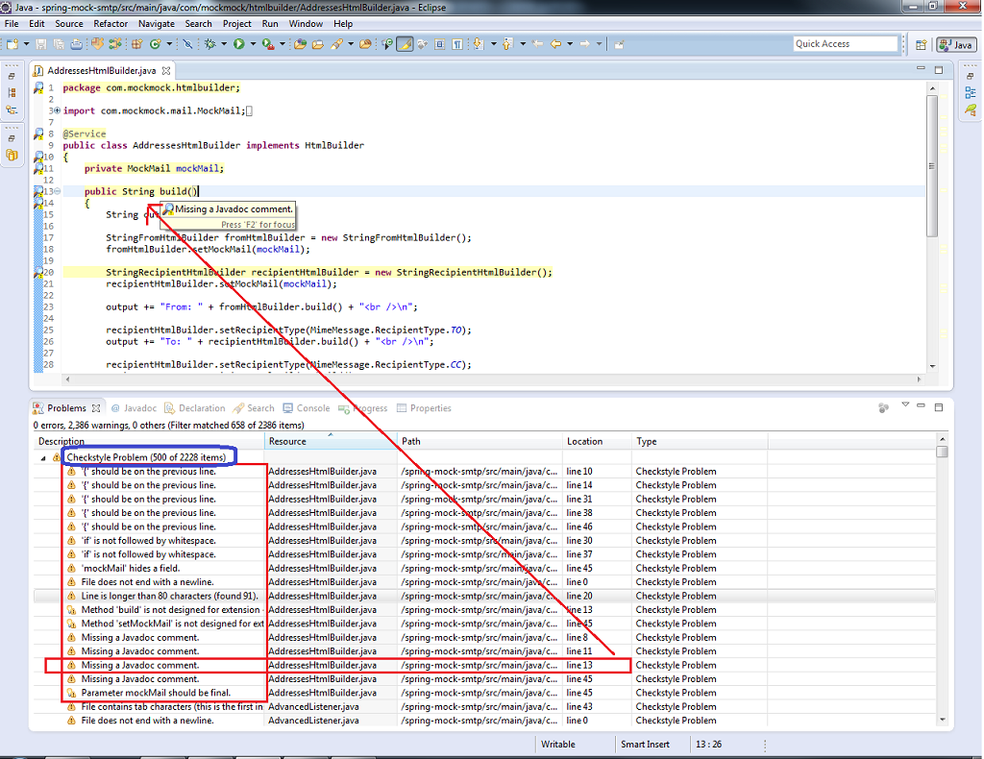

Slide 29
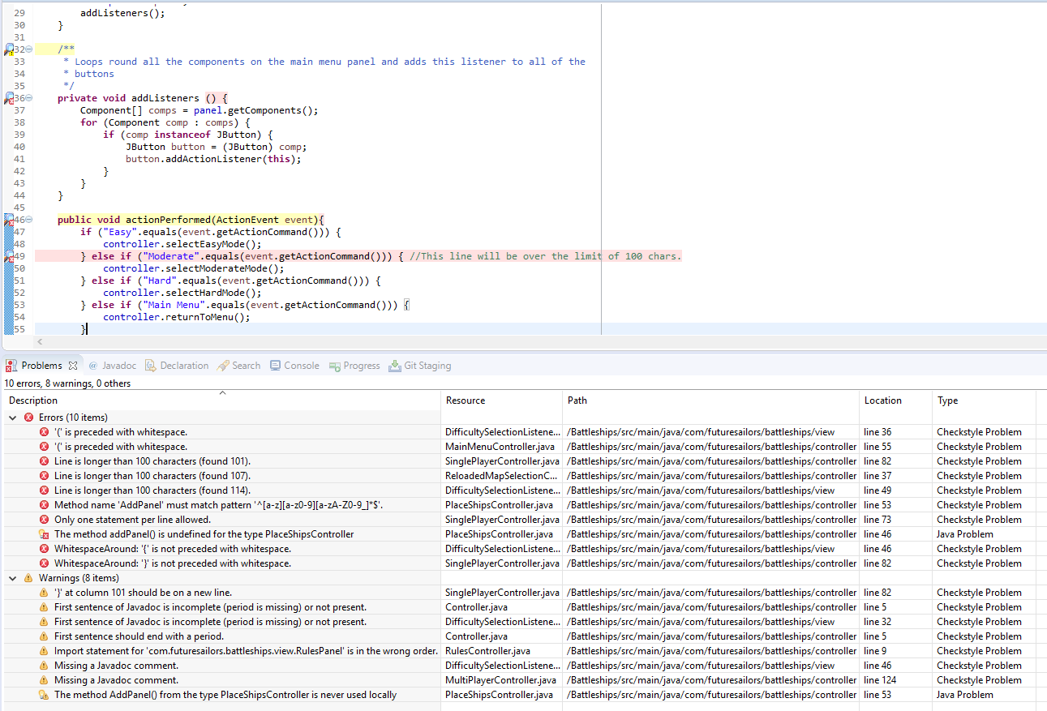

Slide 30
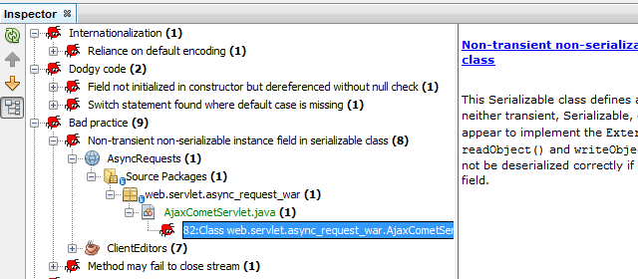
Findbugs

Slide 31
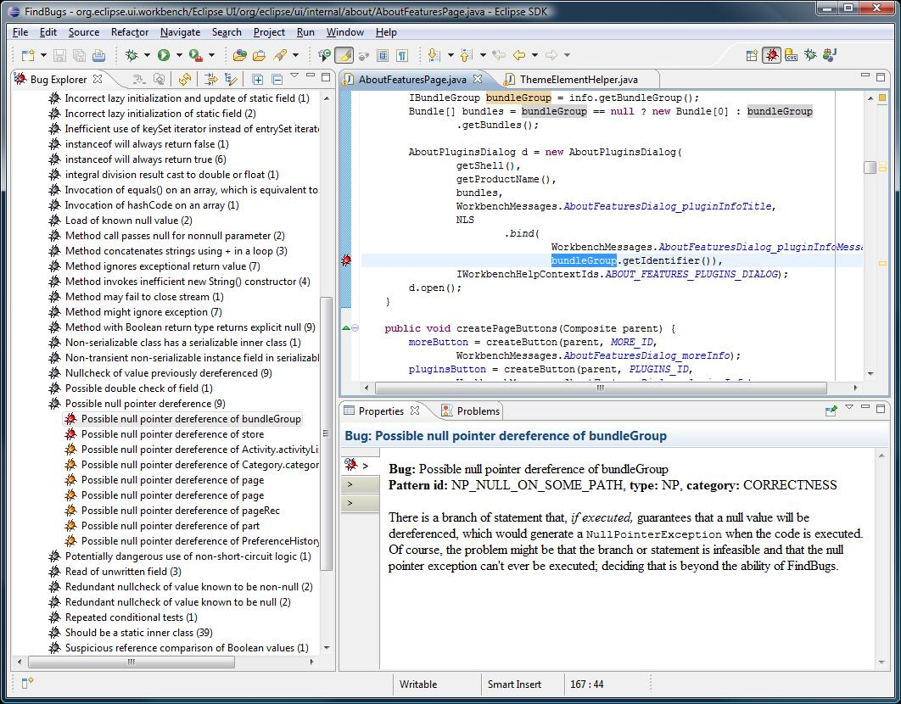

Slide 32
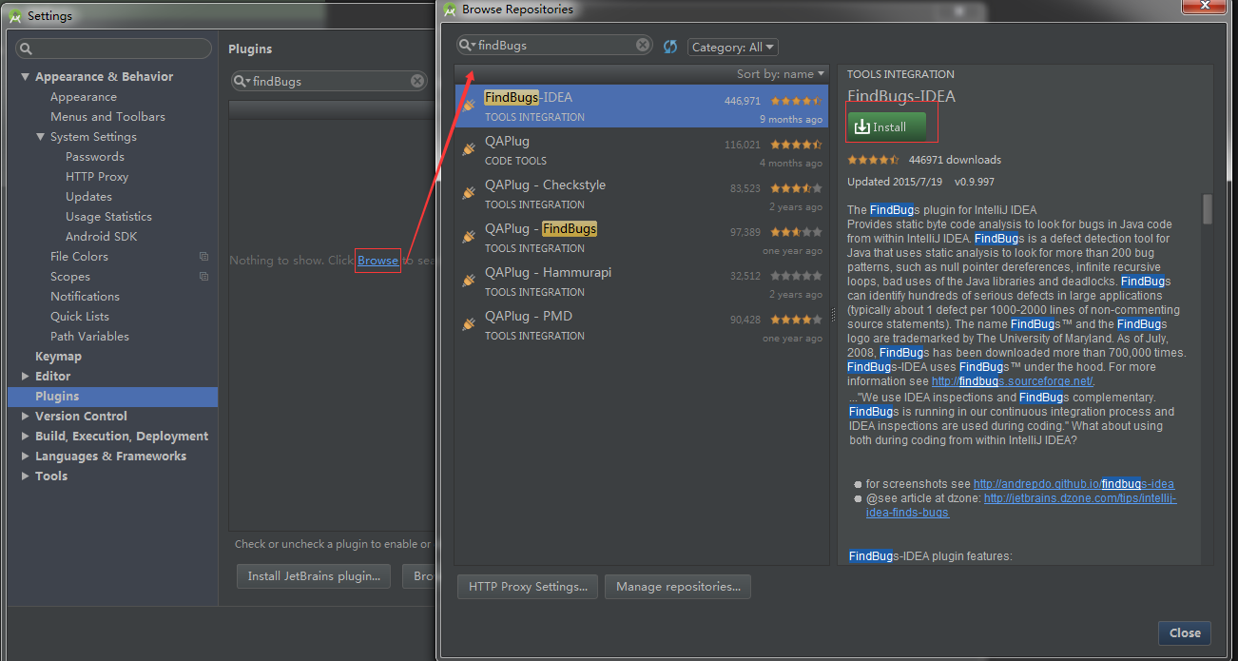

Slide 33
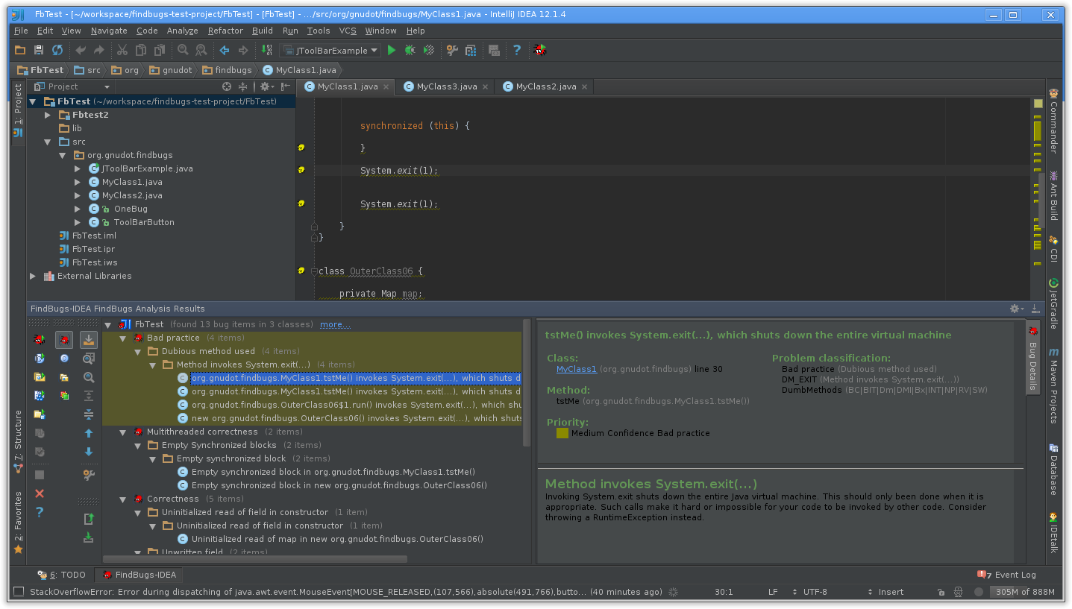

Slide 34
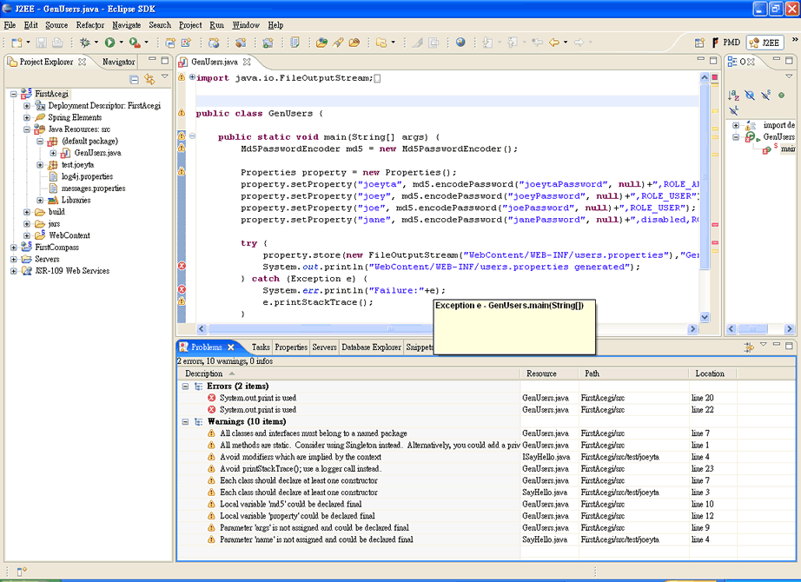

Slide 35

https://youtu.be/o4pdkgHfQS4

Slide 36

BREAK!

Slide 37
Pair Programming
an agile software development technique in which two programmers work as a pair together on one workstation
the driver
writes code
the observer, pointer or navigator
reviews each line of code as it is typed in
The two programmers switch roles frequently
GEMINI SOLUTIONS - DEVELOPMENT FUNDAMENTALS

Slide 38

https://www.youtube.com/watch?v=ET3Q6zNK3Io
Notes:
https://www.youtube.com/watch?v=ET3Q6zNK3Io

Slide 39
Advantages
Economics: 15% more time, 15% fewer defects
Design quality: different prior experiences, larger pool of solutions
Satisfaction: happy, confident
Learning: knowledge sharing
Team-building and communication: increased information flow within the team
GEMINI SOLUTIONS - DEVELOPMENT FUNDAMENTALS
Notes:
Economics
Pairs spend about 15% more time on programs than individuals. However, the resulting code has about 15% fewer defects. Along with code development time, other factors like field support costs and quality assurance also affect the expenses. IBM reported spending about “$250 million repairing and reinstalling fixes to 30,000 customer-reported problems”. Pair programming significantly reduces these expenses by reducing the defects in the programs.
Design quality
A system with two programmers possesses greater potential for the generation of more diverse solutions to problems for three reasons: (1) the programmers bring different prior experiences to the task; (2) they may access information relevant to the task in different ways; (3) they stand in different relationships to the problem by virtue of their functional roles. In the attempt to share goals and plans, the programmers must overtly negotiate a shared course of action when a conflict arises between them. In doing so, they consider a larger number of ways of solving the problem than a single programmer alone might do. This significantly improves the design quality of the program as it reduces the chances of selecting a poor method.
Satisfaction
In an online survey of pair programmers, 96% of them stated that they enjoyed their work more than when they programmed alone. Additionally, 95% of the surveyed programmers stated that they were more confident in their solutions when they pair programmed. A correlation exists between satisfaction among programmers and their confidence in the code i.e. the pairs enjoy their work more because they are more confident in it.
Learning
Knowledge is constantly shared between pair programmers, from tips on programming language rules to overall design skill.[5] In "promiscuous pairing", each programmer communicates and works with all the other programmers on the team rather than pairing only with one partner, which causes knowledge of the system to spread throughout the whole team. Pair programming allows the programmers to examine their partner's code and provide feedback which is necessary to increase their own ability to develop monitoring mechanisms for their own learning activities.
Team-building and communication
Pair programming allows team members to share problems and solutions quickly making them less likely to have hidden agendas from each other. This helps pair programmers to learn to communicate more easily. “This raises the communication bandwidth and frequency within the project, increasing overall information flow within the team.”

Slide 40
Pairing variations
expert - expert
expert - novice
novice - novice
GEMINI SOLUTIONS - DEVELOPMENT FUNDAMENTALS
Notes:
Expert–expert
Expert–expert pairing may seem to be the obvious choice for the highest productivity and can produce great results, but it often yields little insight into new ways to solve problems, as both parties are unlikely to question established practices.[7]
Expert–novice
Expert–novice pairing creates many opportunities for the expert to mentor the novice. This pairing can also introduce new ideas, as the novice is more likely to question established practices. The expert, now required to explain established practices, is also more likely to question them. However, in this pairing, an intimidated novice may passively "watch the master" and hesitate to participate meaningfully. Worse still, the Expert may simply withdraw their labor and get employment elsewhere.[11]
Novice–Novice
Novice–Novice pairing can produce results significantly better than two novices working independently, although, this practice is generally discouraged.[2]

Slide 41
Peer Reviews
reveal errors in function, logic, or implementation
ensure that a work product satisfies its specification
check for conformance to standards
give managers insight into product quality
communicate technical information in a project
enable someone besides the author to support or modify a work product
identify process improvement opportunities
GEMINI SOLUTIONS - DEVELOPMENT FUNDAMENTALS
Notes:
An examination of a software work product by people other than its author in order to identify defects (departures from specifications or from standards) and improvement opportunities.
It’s cheaper to prevent defects than to find and remove them.
If you don’t correct the causes of defects, they’ll be back.

Slide 42
Who Benefits
Developer
Maintainer
Test Engineer
GEMINI SOLUTIONS - DEVELOPMENT FUNDAMENTALS
Notes:
Developer
Less time spent performing rework
Increased programming productivity
Confidence that the requirements are right
Better techniques learned from other developers
Reduced unit testing and debugging time
Less debugging during integration & system testing
Exchanging information with other team members
Maintainer
Fewer production support demands
More robust designs that tolerate change
Conformance of work products to team standards
More maintainable work products
Better understanding of the product from having participated in design and code reviews
Test Engineer
can focus testing on finding subtle defects
fewer defects that block continued testing
improved test design and test cases

Slide 43
Who Benefits
Requirements Analyst
Project Manager
Development Manager
QA Manager
GEMINI SOLUTIONS - DEVELOPMENT FUNDAMENTALS
Notes:
Requirements Analyst
earlier correction of missing or erroneous requirements fewer infeasible and untestable requirements customer validation of requirements
Project Manager
increased chance of shipping on schedule earlier awareness of risks and quality issues reduced risk from staff turnover through cross training
Development Manager
shortened product development cycle time reduced field service and customer support costs reduced lifetime maintenance costs improved teamwork and collaboration
QA Manager
can judge the testability of product features shortened system-testing cycles, less retesting can use review data when making release decisions quality engineers who understand the product ability to anticipate QA effort needed

Slide 44
Cultural Barriers to Peer Reviews
Fear of public ridicule or criticism
Previous negative review experiences
Fear that management will hold defects against the author
Attitude that “my work doesn’t need reviewing”
Concern that reviews will slow the project down
Review outcomes that managers overrule
Belief that testing is faster
National or team cultures that avoid personal criticism
GEMINI SOLUTIONS - DEVELOPMENT FUNDAMENTALS

Slide 45
Informal or formal?
Informal Reviews
No defined process or participant roles
Usually ad hoc, rather than planned
Examples: walkthrough, peer deskcheck, passaround
Formal Reviews
Defined review objectives
Follow a documented review process
Defined participant roles and trained team
Checklists, rules, or analysis methods used to find defects
Management report produced on product status
Data collected for quality control and process management
GEMINI SOLUTIONS - DEVELOPMENT FUNDAMENTALS

Slide 46
Common peer review traps
Reviews are skipped under time pressure.
People think their projects are too small to benefit from reviews.
Reviewers aren’t adequately prepared.
Meetings drift into finding solutions, not problems.
Reviewers criticize the author, not the product.
Reviewers turn into lecturers.
Authors become defensive.
Review teams are too large.
GEMINI SOLUTIONS - DEVELOPMENT FUNDAMENTALS

Slide 47
Do’s and Don’ts
Do’s
Regard finding a defect as a “good catch.”
Avoid being distracted by style issues.
Emphasize finding — not fixing — defects during the review.
Make everyone’s work subject to review.
Check the significant portions of the material first.
Train the reviewers.
Emphasize defect prevention.
Use reliable tools that ease the review process and promote collaboration
Don’ts
Use data collected from reviews to punish or reward individuals.
Attribute defect data to individual authors.
Track who finds the most defects.
Use reviews to find scapegoats for project problems.
Use untrained or reluctant review moderators.
Include participants who are not there to find defects.
GEMINI SOLUTIONS - DEVELOPMENT FUNDAMENTALS

